Slide 1

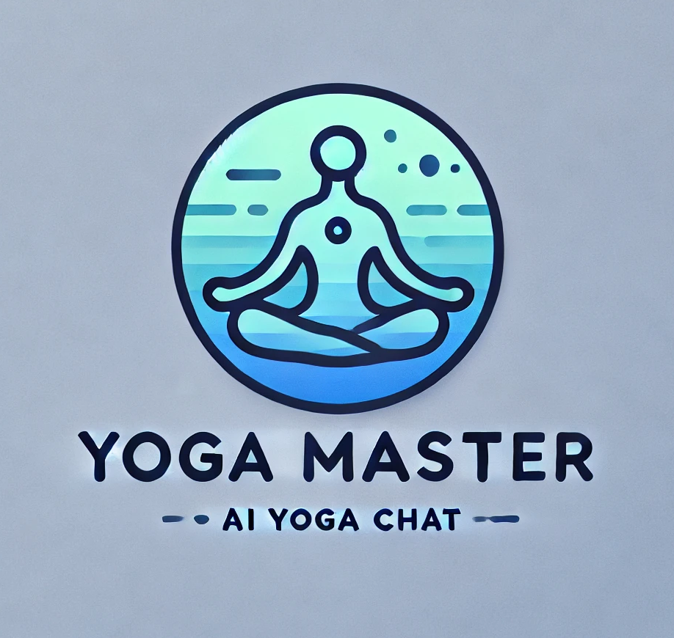
group 7
Dong Yuantong (A0292041N) | Gao Yunjia (A0295502E) | Li Qiuxian (A0297598X)
Liu Weixuan (A0295682M) |Zhao Lanting (A0297676A)

Slide 2

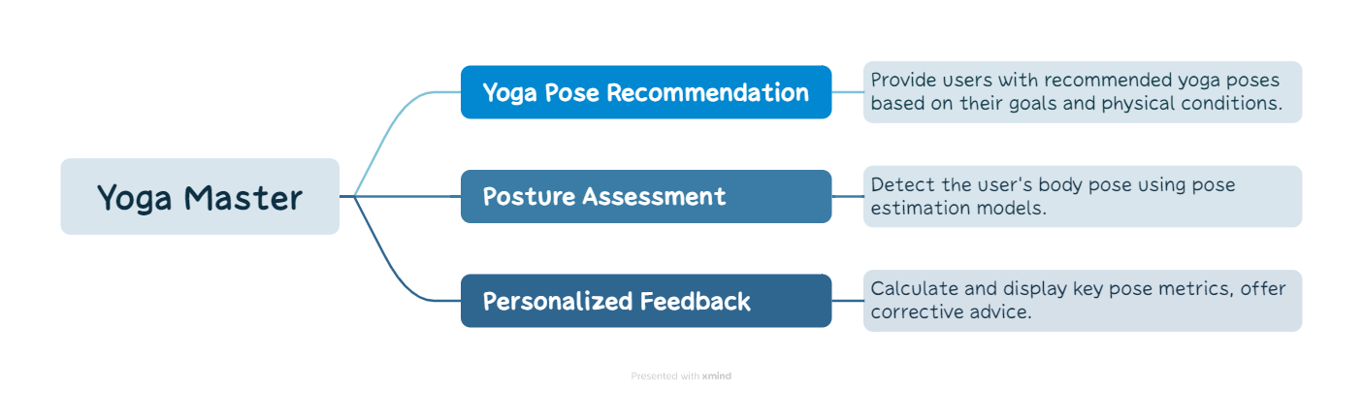
Introduction to Yoga Master
A system that recommends personalized yoga poses to users, evaluates their posture from uploaded photos, and provides precise corrections along with feedback for improvement.
3 parts

Slide 3
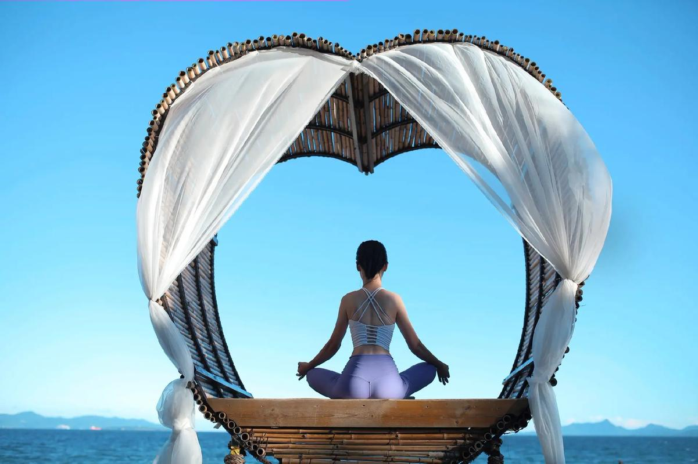
Objectives of Yoga Master
This project aims to develop an intelligent yoga recommendation and evaluation system using NLP, machine learning, ensemble methods, and computer vision technologies to ensure the safety and effectiveness of practice.

Slide 4
Project Scope
Yoga Pose Recommendation Engine:
A user interface for selecting yoga goals (e.g., flexibility, relaxation) and physical conditions.
A backend recommendation system that suggests yoga poses based on the user profile.
Pose Estimation Module:
Integration of a pose estimation model to analyze uploaded photos and extract key body points.
Extraction of key joints (e.g., shoulders, elbows, hips, knees) to compare the user’s pose with standard poses.
Pose Comparison Algorithm:
A function to calculate the angle of joints based on key points extracted from the user’s photo.
A comparison algorithm that analyzes the user’s pose against the standard yoga pose, detecting deviations in angle and position.
A scoring system that assesses posture accuracy and provides corrective feedback.
User Feedback System:
Generate detailed, easy-to-understand feedback on what to improve, with a focus on specific body parts.
Provide guidance on how to modify or correct the pose.

Slide 5
—— Background Overview
Market Context
Increased Focus on Well-being: Fast-paced lifestyles and rising stress levels drive interest in yoga for both physical and mental health.
Yoga’s Growth: The global yoga market is expanding due to its health benefits, such as improved flexibility, strength, stress relief, and anxiety management. The global yoga market is expected to continue growing in the coming years.
Problem: Despite yoga's popularity, there’s a lack of personalized guidance and posture evaluation tools, especially in home practice settings.

Slide 6
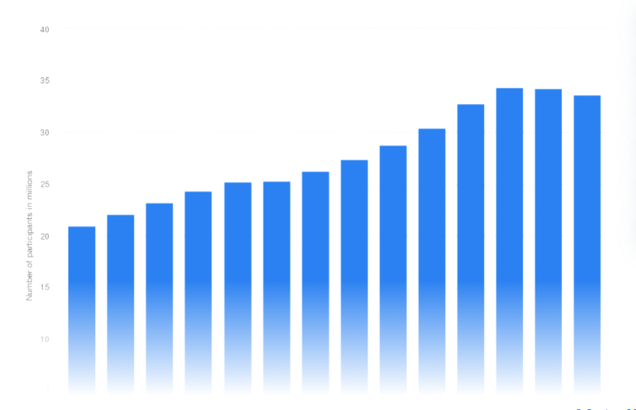
Yoga’s Growth:
According to QYResearch, the global yoga apparel market will reach $27.63 billion in 2023. The yoga and fitness app market is projected to reach $66 billion by 2027.
“ Number of yoga participants in the United States from 2010 to 2023”
Reference: https://www.statista.com

Slide 7
Business Value
User Benefits
Effectively enhance the user’s practice experience
Avoid potential injuries
Help users achieve more efficient workout results and health goals
Better and happier using the system as it provide personalised search experience
Company Benefits
Enhance users' satisfaction and loyalty through differentiated competitive advantages
Expand user base and increase platform engagement
Help capture market demand opportunities and achieve business growth
Notes:
Users
Happy and less frustrated
Something tangible
Saves time & effort
Convenience
Company
Higher conversion rates
Higher revenue
Higher retention rates
Upselling opportunities

Slide 8
Data Collection & Processing
Manually labeling
Pose with label
Yoga Pose Dataset
Combine
Construct Yoga Pose Dataset
Pose with
key-point
PoseNet estimation

Slide 9
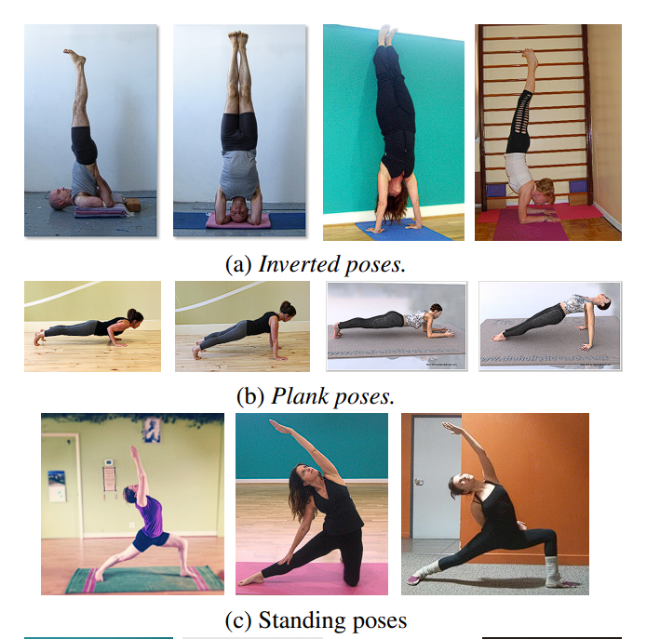
Data Collection
Yoga Pose Dataset
Publicly available datasets
Collect custom data.
Diversity of Data
Body Types and Flexibility Levels
Angles and Lighting
Camera Positioning

Slide 10
Data Pre-processing
Manually labeling:
Labeled with different user conditions and preferences (e.g. sports performance, uncomfortableness, etc.)
Data Augmentation:
Augment the dataset by rotating, scaling, and flipping images to simulate various camera orientations and scenarios.
Key-point Detection:
Each image or video frame will be annotated with key points representing major body joints.
Training and Validation Splits:
Training set will be used for model learning, while the validation set will help tune hyperparameters. The test set will evaluate the system’s final performance.

Slide 11
System Architecture
Back End
Construct Pose Dataset
Yoga Pose Dataset Clustering
Pose Comparison and
Error Analysis
Symmetry Analysis
Overall Body Line Assessment
User Info Input
Yoga Pose Recommendation
Feedback Generation
Recommend Pose
Joint Angle Calculation
Relative Joint Positioning
Recommend Pose
User Photo Upload
Yoga Pose Estimation
Front End

Slide 12
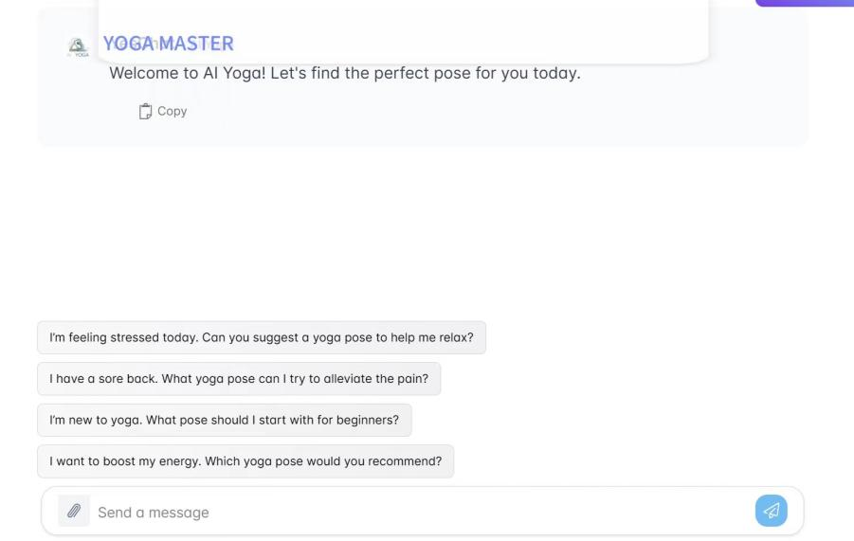
Module Design
User Information Collection and Interaction Module
Intelligent Dialogue Guide: Interact with the user via NLP to collect basic information, such as age, gender, height, and weight.
Health Condition and Yoga Level Assessment: Ask about the user’s health conditions (e.g., back pain, knee problems) and yoga experience level during the interaction. Then generate a health assessment report.
Personalized Goal Setting: Inquires about the user’s specific yoga goals, such as stress relief, core strength improvement, or flexibility enhancement.
Data Storage and Management
age, gender, height,
and weight
collecting:
basic personal information,
health conditions,
and yoga goals
health assessment report and yoga level
Yoga Master Chat Interface Example

Slide 13
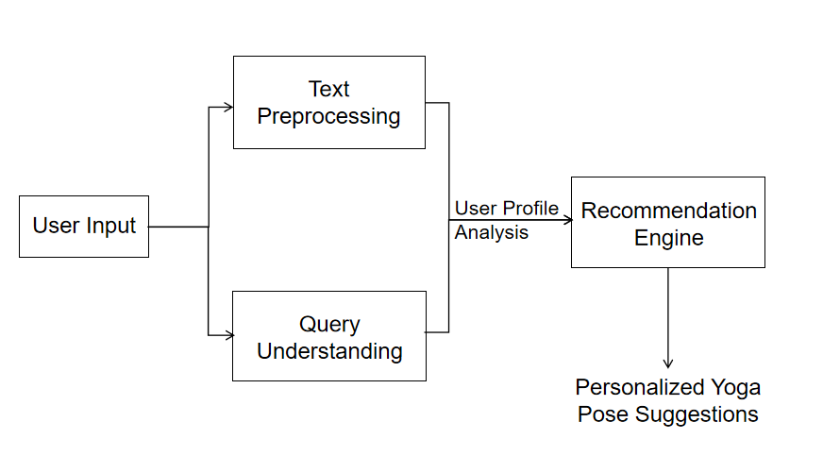
Yoga Master Pose Recommendation System Flowchart：
·User Input: Users provide information for personalized recommendations.
·Text Preprocessing: Input data is cleaned and standardized for consistency.
·Query Understanding: The system extracts key elements from user input to identify needs.
·User Profile Analysis: User profiles are analyzed to gain insights into preferences.
·Recommendation Engine: Matches user needs with suitable yoga poses from a database.
·Personalized Suggestions: Delivers tailored recommendations to guide users toward appropriate poses.

Slide 14
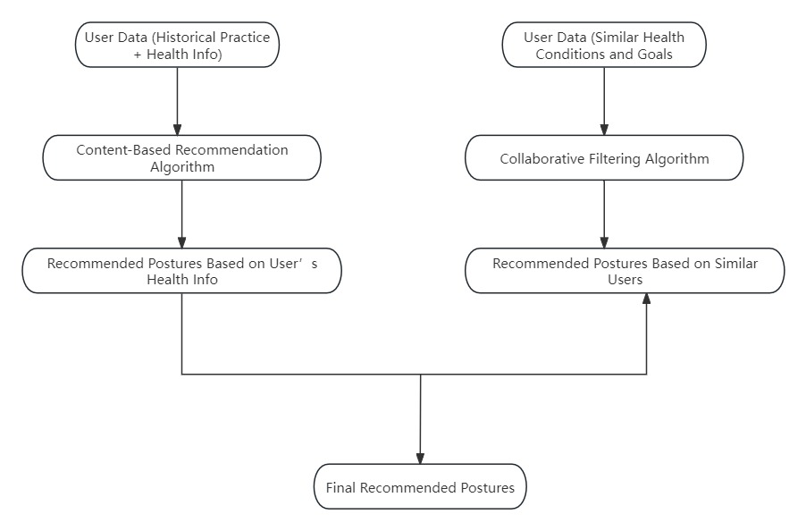
Personalized Yoga Posture Recommendations
Health Conditions
Personal Goals
Main recommendation algorithms
Content-Based Recommendation Algorithm: This algorithm recommends postures based on the user’s historical practice data and health information (e.g., back pain or knee problems). For instance, if the user has back issues, the system will recommend back-friendly poses.
Collaborative Filtering Algorithm: This algorithm analyzes practice data from users with similar health conditions and goals, recommending commonly practiced postures by those users.
Recommendation System Using Content-Based and Collaborative Filtering

Slide 15
Yoga Pose Estimation
Construct Pose Dataset
Yoga Pose Dataset Clustering
Pose Comparison and
Error Analysis
Joint Angle Calculation
Feedback Generation
Relative Joint Positioning
Symmetry Analysis
User Photo Upload
Yoga Pose Estimation
Overall Body Line Assessment
The Pose Assessment Module is primarily responsible for detecting and identifying body key points from the photos uploaded by users. By comparing the detected poses with standard yoga poses, the module evaluates the correctness of the user's posture.

Slide 16
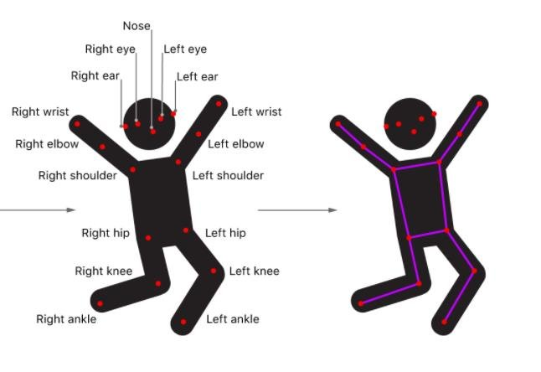
Yoga Pose Estimation
Step 1. Use Yolo11 to Extract Key Points from the Dataset
Yolo11: Key Points
Yolo11
Accurate detection with 17 key-points
Real-time capability
Low computational requirements
Fine-tuned with yoga dataset

Slide 17
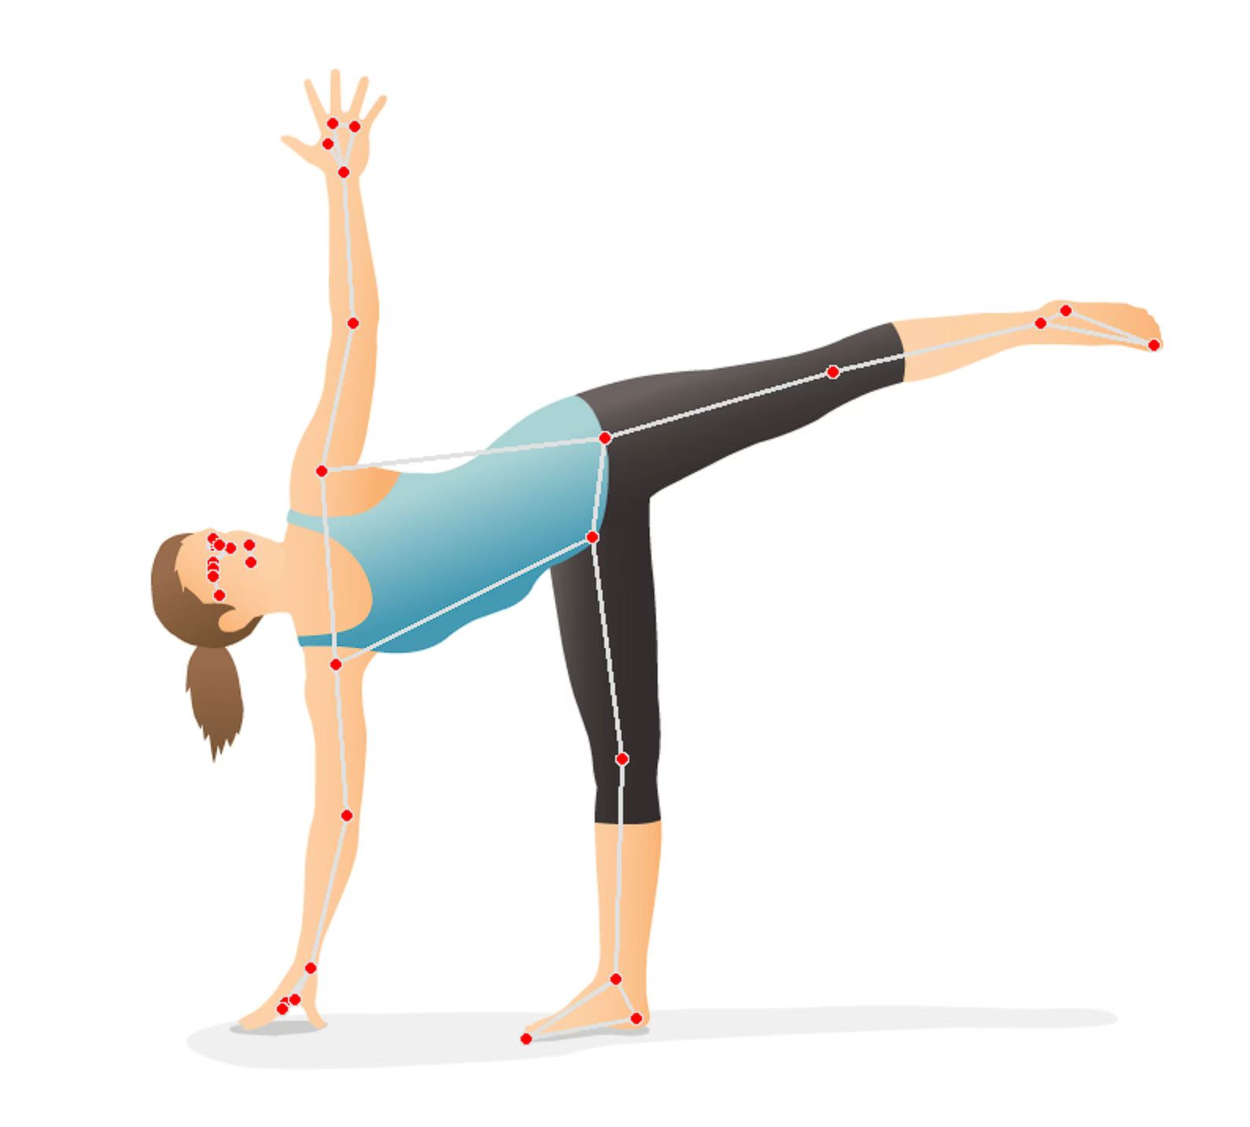
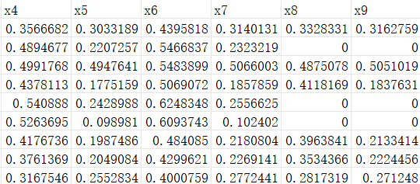
Yoga Pose Estimation
Step 1. Use Yolo11 to Extract Key Points from the Dataset
Applied to the Dataset
Use pose estimation models like Yolo11 to extract key points
Key points include shoulders, elbows, knees, and hips
Store extracted data in a structured format for analysis

Slide 18
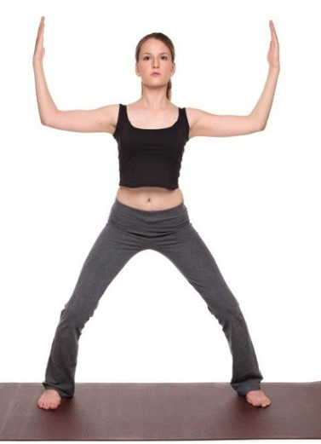
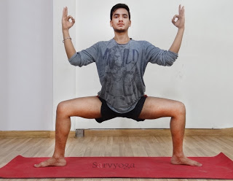
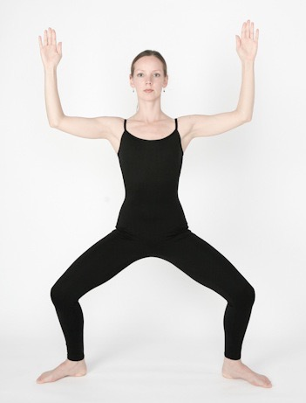
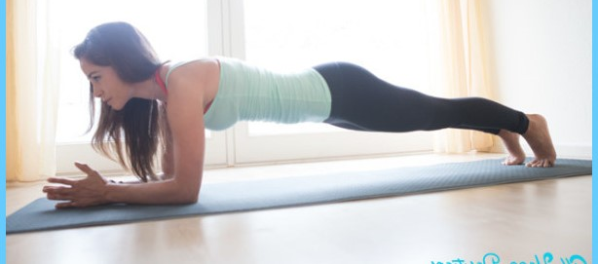
Yoga Pose Estimation
Step 2. Pose Comparison and Error Analysis
The system will evaluate the user's pose consistency with the standard pose from the following aspects:
Joint Angle Calculation
Relative Joint Positioning
Joint Angles:
Evaluating the correctness of shoulder, knee, and hip positions
Relative Joint Position:
Positioning of joints relative to each other
(e.g. knee-to-ankle alignment)
Symmetry Analysis:
Comparing left and right side body alignment
Body Line Assessment:
Spine, leg extension, and overall body coordination
Symmetry Analysis
Overall Body Line

Slide 19
Yoga Pose Estimation
Step 3. Specific methods of comparison
1. Calculate Standard Pose Features
Calculate joint angles, relative positions, and slopes for key points
Perform statistical analysis (mean and standard deviation) on the features of the standard poses
3. Generate Standard Pose Model
Define the standard pose using the threshold ranges
Prepare the model for comparison with user-uploaded poses
4. User Pose Comparison
Calculate key point features for the user-uploaded pose
Compare the user pose with the standard pose (joint angles, relative positions, slopes)
Evaluate pose accuracy based on predefined thresholds
2. Define Thresholds
Set thresholds based on the calculated mean and standard deviation
Establish tolerance ranges to accommodate individual variations

Slide 20
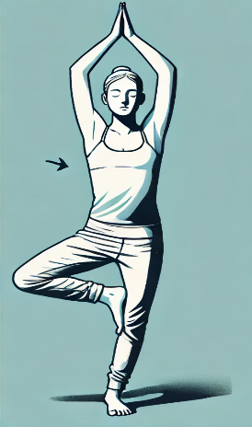
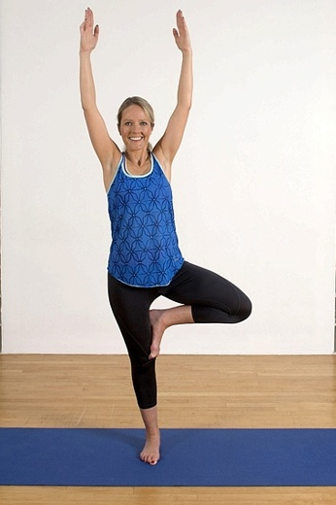
Yoga Pose Estimation
Step 4. Real-time User Feedback
Posture Analysis and Improvement Feedback
Pose: Warrior II
Overall Score: 7.5/10
System generates clear, actionable feedback based on the pose comparison.
Corrective suggestions for specific body parts:
- Example: 'Left knee bent too much'
Performance scores based on posture accuracy.
Joint Angles:
Left Knee Joint: Current angle is 95°, standard is 90°. Move the knee slightly outward to keep it aligned over the ankle.
Body Line:
Spine: The spine is generally straight, with a slight curvature that is within acceptable limits.
...
Improvement Tips:
Shoulder Adjustment Exercise: Strengthen shoulder balance by practicing exercises like lateral raises with dumbbells.
Ground truth
Yoga pose
User input

Slide 21
Technology Overview
Frontend Technologies:
Vue.js: For building dynamic user interfaces.
HTML/CSS: For page structure and styling.
Axios: For API communication with the backend.
Backend Technologies:
Node.js and Express.js: For handling API requests.
MongoDB: For storing user and pose data.
Python: For machine learning and data processing.
Pandas and NumPy: For data analysis tools.
Yolo11: For pose estimation and keypoint extraction.

Slide 22
Technology Overview
Recommendation System Technologies:
Content Recommendation Algorithm: For recommending poses based on user history.
Collaborative Filtering Algorithm: For analyzing data from similar users.
Natural Language Processing (NLP): Using NLTK or spaCy.
Deep Learning: Using TensorFlow or PyTorch.

Slide 23
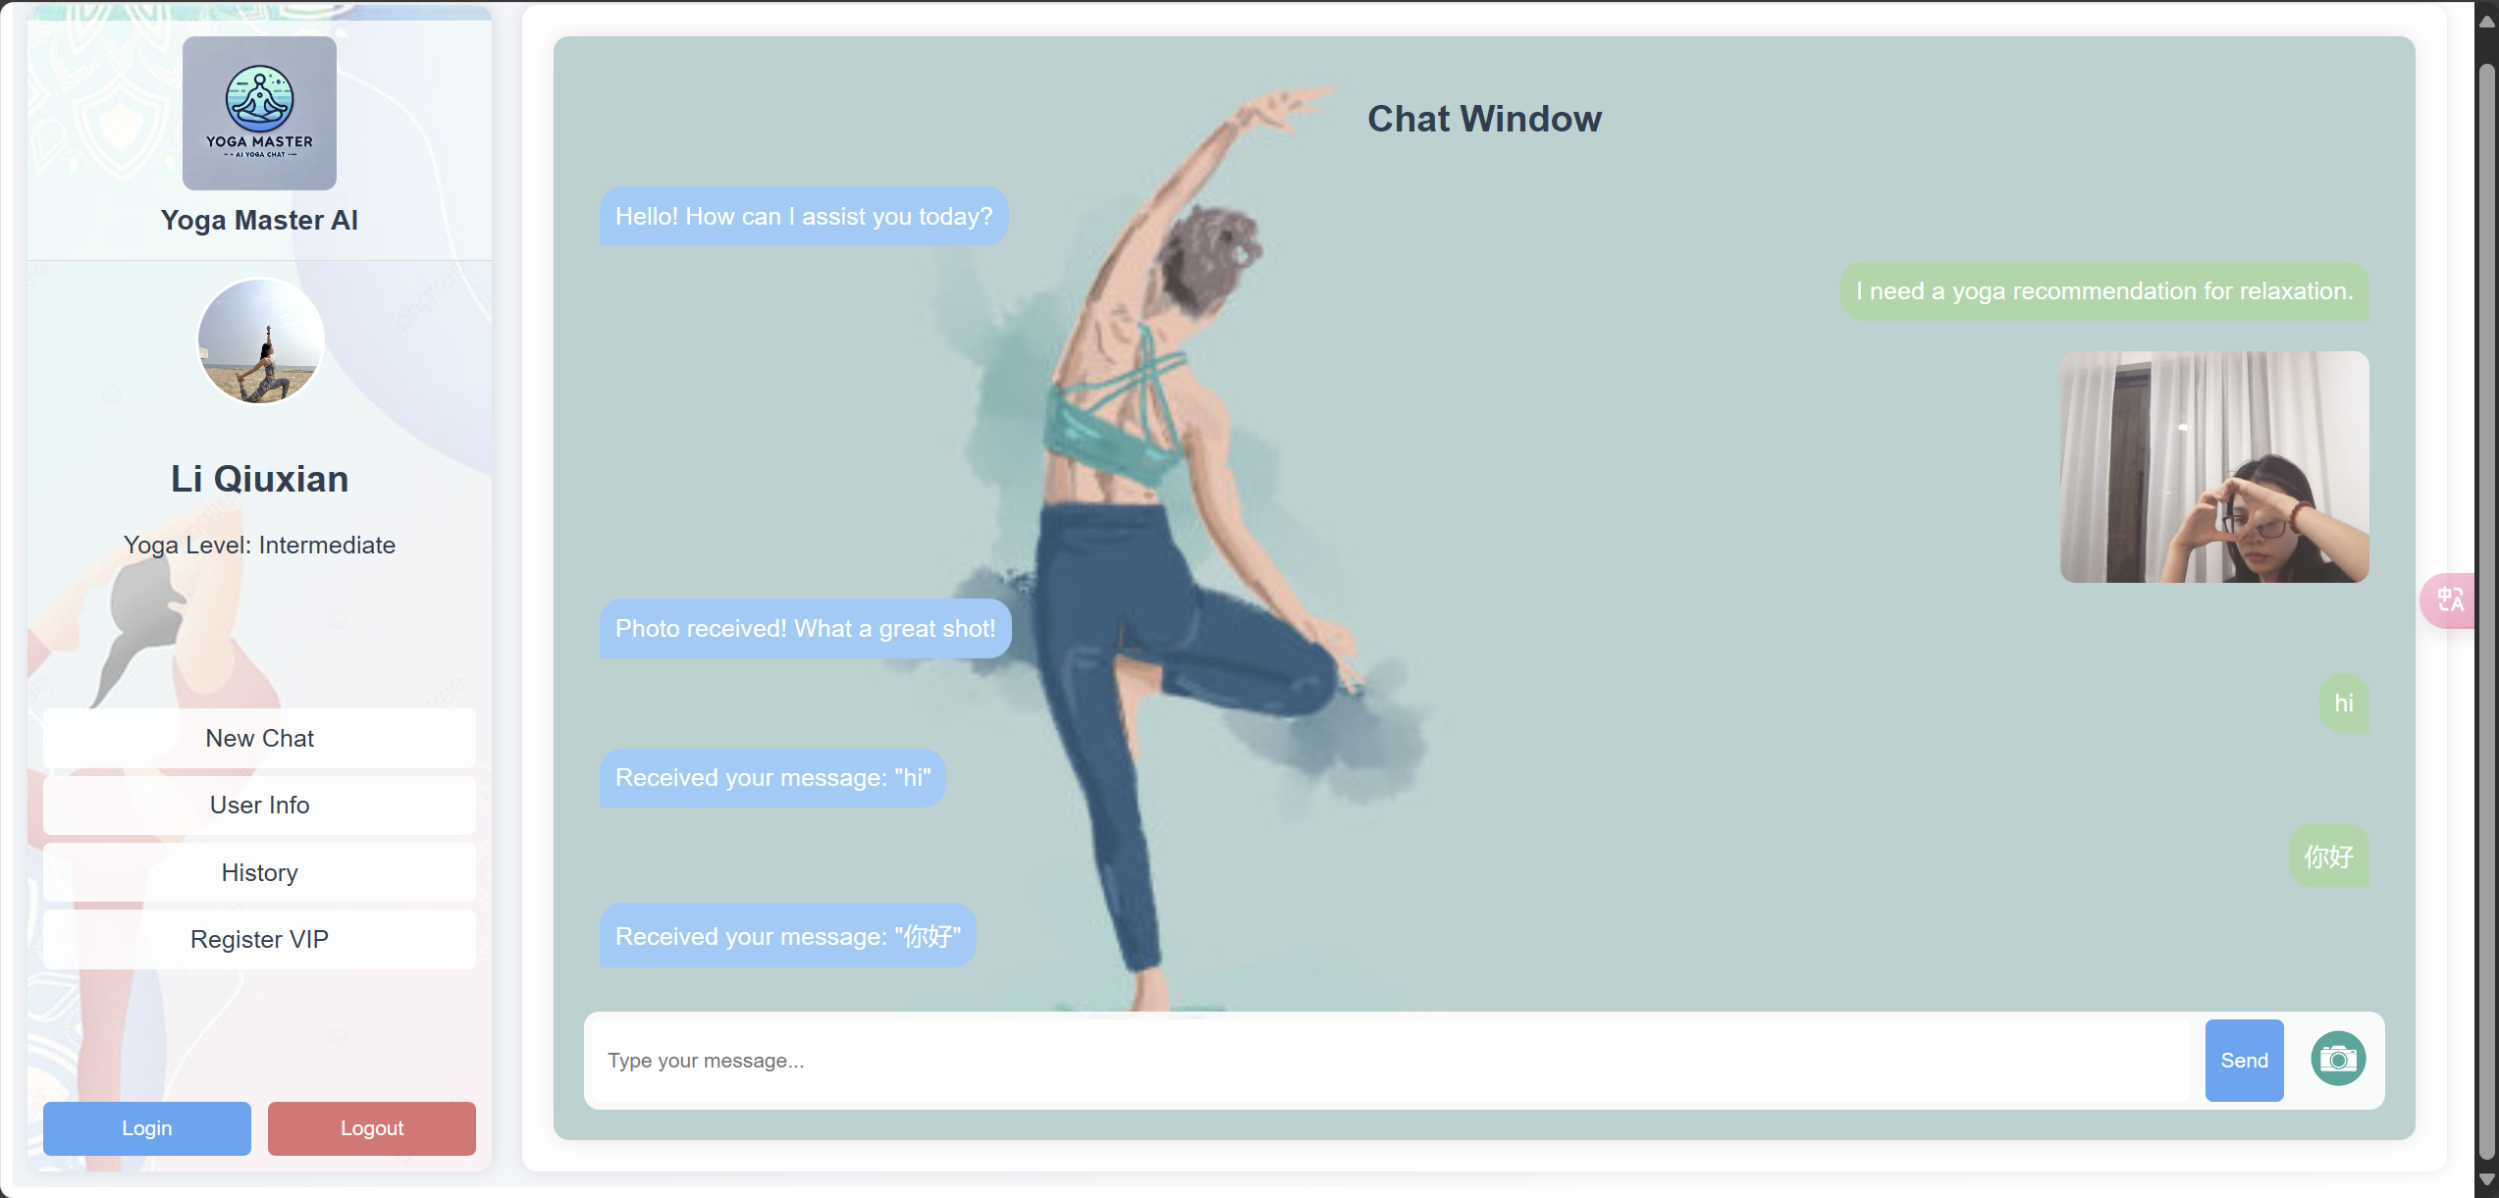
What we have done so far
We have made good progress on the Yoga Master project:
Frontend: Built a responsive UI with Vue.js for easy navigation and photo uploads.
Backend: Completed part of the backend with Node.js and Express.js, including server setup and API endpoints.

Slide 24
Recommendation Model: Trained the model using historical data for personalized yoga pose recommendations.
Yoga Pose Estimation:
1. Use YOLOv11 to extract key point coordinates for each yoga pose in the dataset.
2. Define the standard pose by applying thresholds to the joint angles, symmetry, and slopes of the key points.
3. Recalculate the features for the user-uploaded photo and determine if the pose is standard.

